Slide 1

Week-1 Overview
F.O.T.A
Team IV

Slide 2

Expected
PC connected to the Rπ with UDP protocol and capable to send .elf file to it.
Rπ can flash the .elf file on the µc.

Slide 3

Acheived
PC connected to the Rπ with UDP protocol and capable to send .elf file to it.
PC application is connected to google cloud server and uploads the file. The Rπ fetches (download) the file from the server.
Rπ can flash the .elf file on the µc.
Rπ flashes the .elf file on the µc by communicating with the bootloader in a defined process.

Slide 4
Acheived
PC application is connected to google cloud server and uploads the file. The Rπ fetches (download) the file from the server.
PC App check status.
Encryption and security checking.
Rπ flashes the .elf file on the µc by communicating with the bootloader in a defined process.
Error handling.
Doxygen reports.

Slide 5
Project block diagram
PC Application
µC
Rπ
3
1
2
Server
4
5
Python GUI Application
Rπ scripts
Google Cloud server
ST bootloader

Slide 6
PC GUI application.
F.O.T.A
Team II

Slide 7
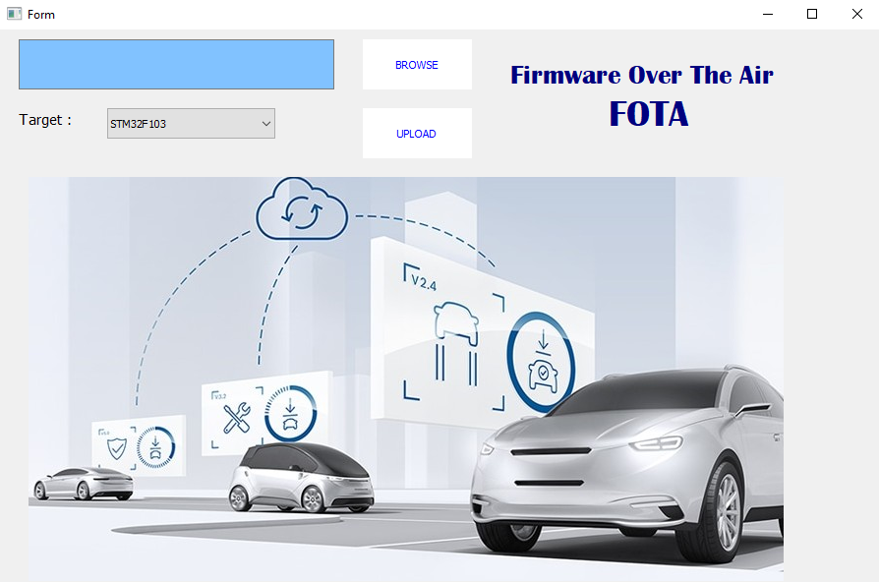
GUI design

Slide 8
Libraries Used
PyQt.
GUI designing.
Google.cloud.
Server communication.

Slide 9
Browse button
.elf path
Application GUI description
After pushing the UPLOAD button the .elf file will be uploaded to the google cloud server.
The application will write on the “Request.txt” a new request with the following format:
New Firmware Target .elf_file
Select target
Upload file to server

Slide 10
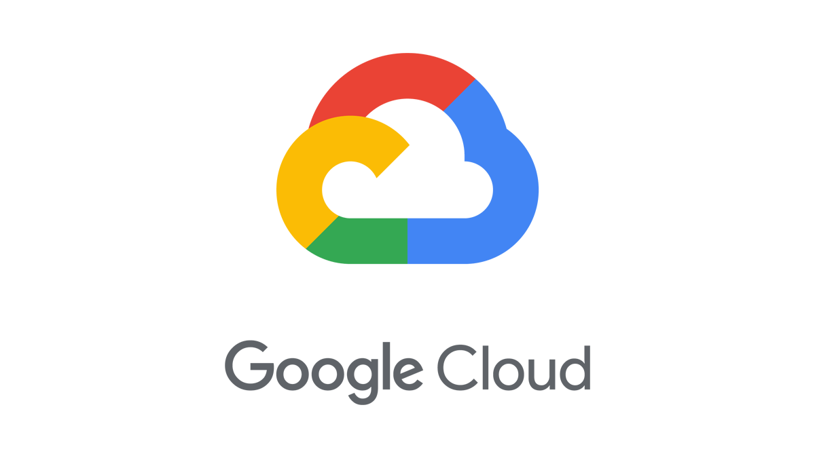
Google Cloud server
F.O.T.A
Team II

Slide 11
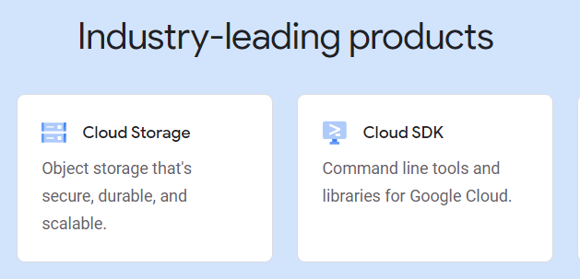
Google Cloud

Slide 12
Google Cloud
“The same security technology that supports Google’s private global network protects your data while meeting rigorous industry-specific compliance standards.” https://cloud.google.com/why-google-cloud
Gain real-time visibility into who’s accessing your data and reduce risk by ensuring that only the right users can do so.

Slide 13
Google Cloud
Strategic partnerships with leading open source-centric companies in data management and analytics allow us to tightly integrate such services into Google Cloud, making it easy for enterprise customers to build and use apps in the public cloud.
Our specialists and partners can help you use Google technology—infrastructure, analytics, AI, and more—to solve your most challenging problems.

Slide 14
Google Cloud
Project
Bucket.
Files.
Request.txt
App.elf
Logs.txt

